Slide 1

Go, change the world
RV College of
Engineering
Department of Master of Computer Applications
18MCA56 - Minor Project-II – Phase 2
Speech Emotion Recognition System Using Machine Learning
Under the Guidance
of
Dr S Anupama Kumar
Associate Professor
Department of MCA
RV College of Engineering
Chaitra B V (1RV19MCA21)
Janvi Nagesh Naik (1RV19MCA35)

Slide 2
Agenda
Objectives
Functional and Non-functional Requirements Architectural Design
System Design
Implementation (Current Status/ Main Functions)

Slide 3
Objectives
To build a model to recognize emotion from speech using the librosa and sklearn libraries and the RAVDESS dataset
To identification of the emotional state of humans from their voice with maximum accuracy.
To classify emotions in speech (sad, happy, and angry)
To improve man-machine interface.
It can also be used to monitor the psycho physiological state of a person in lie detectors

Slide 4
Functional Requirements
Functional requirements:
They are the list of functionalities that are provided by the system or its component. It is the reaction of the system to a particular input or the behaviour of the system in a particular situation to a particular input.
The Main functional requirements are:
    The user has to record the input using UI interface(the input will be audio file)
    These input will be used to predict the emotions in speech

Slide 5
Functional Requirements
      Input :
      Loading the required RAVDESS Data set with length of 1439 Audio
      RAVDESS: This dataset includes around1500 audio file input from 24 different actors (12 male and 12 female) where these actors record short audios in 8 different Emotions.
      1 = neutral, 2 = calm, 3 = happy, 4 = sad, 5 = angry, 6 = fearful,
      7 = disgust, 8 = surprised. Each audio file is named in such a way that the 7th character is consistent with the different emotions that they represent.

Slide 6
Functional Requirements
      Process:
      Using speech recognition API to convert audio into text:
      Use the Speech-Recognition API to get the Raw Text from Audio Files. Though Speech Recognition is less strong for large chunk of files , so used Error Handling , where when it is not be able to produce the text of a particular Audio File it prints the statement error just for understanding Audio

Slide 7
Functional Requirements
Process:
Masking and Cleaning :
    Down sampling of audio files is done and Put mask over it and direct into clean folder.
    Mask is to remove unnecessary empty voices around the main audio voice.
    Feature Extraction of Audio Files Function :
    Extract features from a sound file
    Labels Classification:
    Emotions in the RAVDESS dataset to be classified Audio Files

Slide 8
Functional Requirements
Process:
    Loading of data and splitting of dataset(training and testing data):
    Load the data and extract features for each sound file
    Applying the multi layer perceptron classifier:
    Initialize the Multi Layer Perceptron Classifier
    Train the model
    Saving the model

Slide 9
Functional Requirements
Output:
Predicting the test data using the saved model:
    Store the Prediction probabilities into CSV file
    Recorded using microphone
    Applying extract feature function on random file and then loading model to predict the result

Slide 10
Non Functional Requirements
NON-FUNCTIONAL REQUIREMENTS
A non-functional requirement is a requirement that specifies criteria
that can be used to judge the operation of a system, rather than specific
behaviours.
User Friendly : It is user friendly in nature and easy to understand.
Availability : It can be accessed from anywhere at any time.
It means 24 X 7 availability.

Slide 11
Flexibility : The application is capable to support any web-browser.
Memory Utilization: Data is stored at central database so memory is completely utilized.
Portability: An end-user can use this system on any OS; either it is Windows or Linux. The system shall run on PC, Laptops, and PDA etc.
Security: The application asks for the permission of the microphone by the user to record the audio

Slide 12
Non Functional Requirements
Performance requirements:
  Operating System : Windows 10, Linux
  Platform : Spyder IDE
  Tools : Anaconda for python 3.6.5
  Libraries : librosa, soundfile, sklearn
  Front-End : Django
  Back-End : Python

Slide 13
Architectural Design
Problem Specification
The Speech emotion recognition systems have the aim of recognizing emotions, in this case, from the speech. The Speech emotion recognition aims to recognize the underlying emotional state of a speaker from the voice signal.
The problems introduced to these systems are:
  How the emotions are presented inside an audio signal?
  How can a classifier use labelled samples to classify the emotion of a new one?

Slide 14
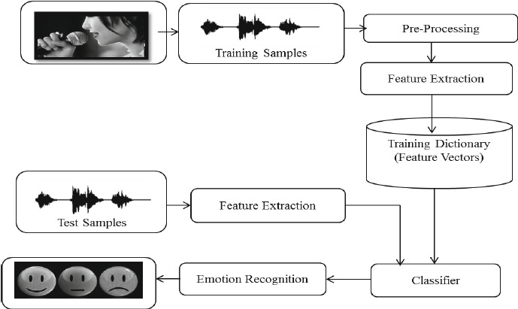
Architectural Design
Block Diagram

Slide 15
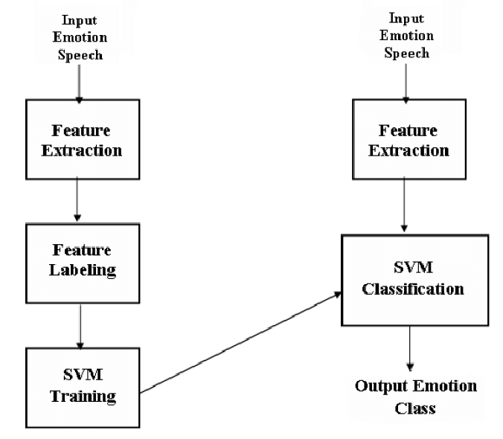
Architectural Design
Object modeling : Class Diagram
MLP
MLP

Slide 16
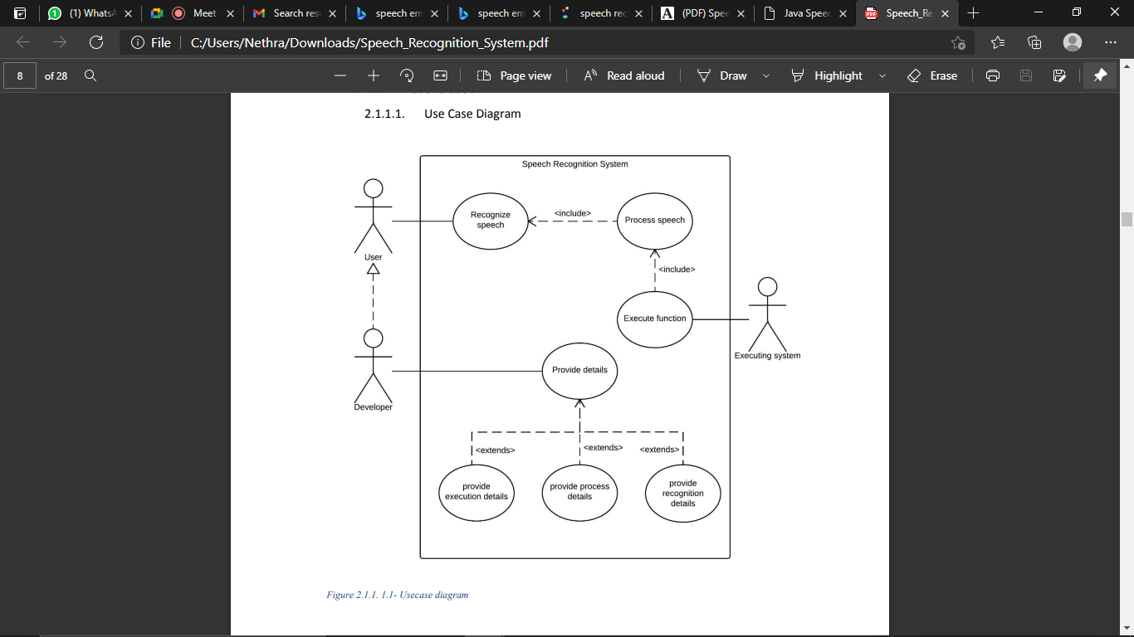
Architectural Design
Dynamic modeling : Use Case Diagram

Slide 17
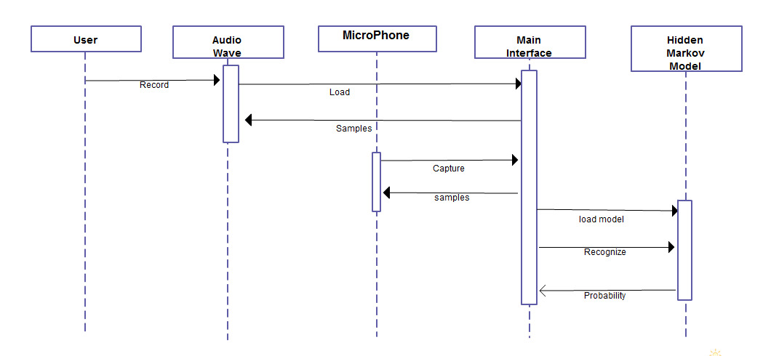
Architectural Design
Dynamic modeling : Sequence Diagram

Slide 18
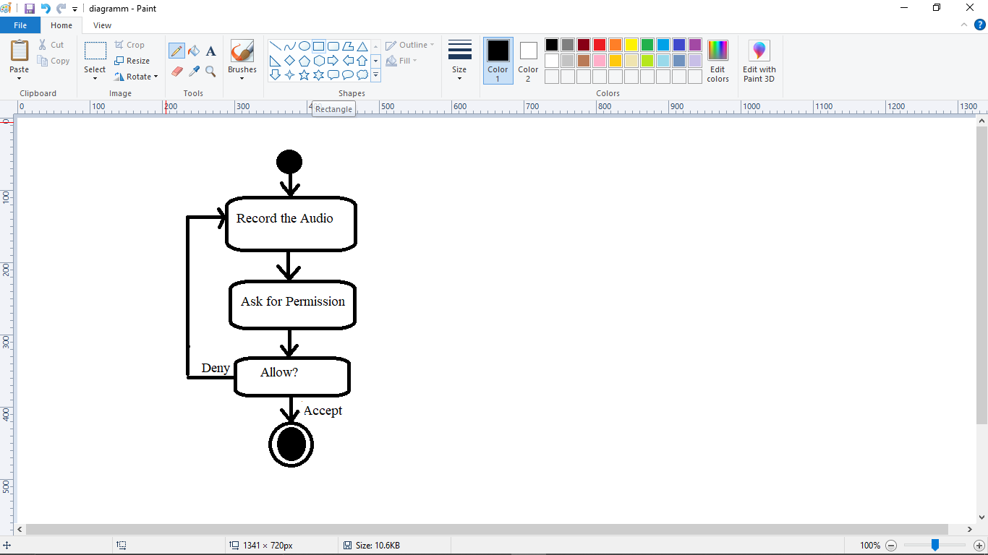
Dynamic modeling : Activity Diagram

Slide 19
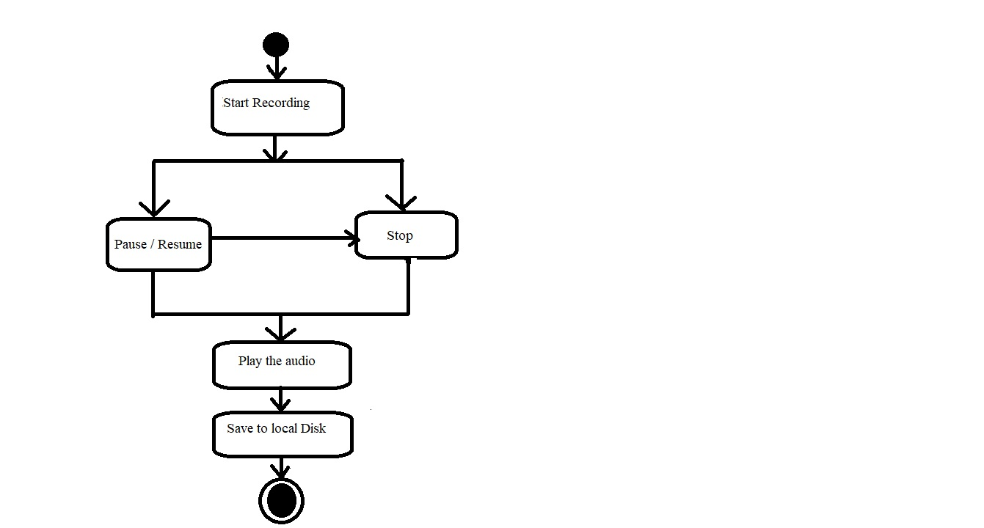
Dynamic modeling : Activity Diagram

Slide 20
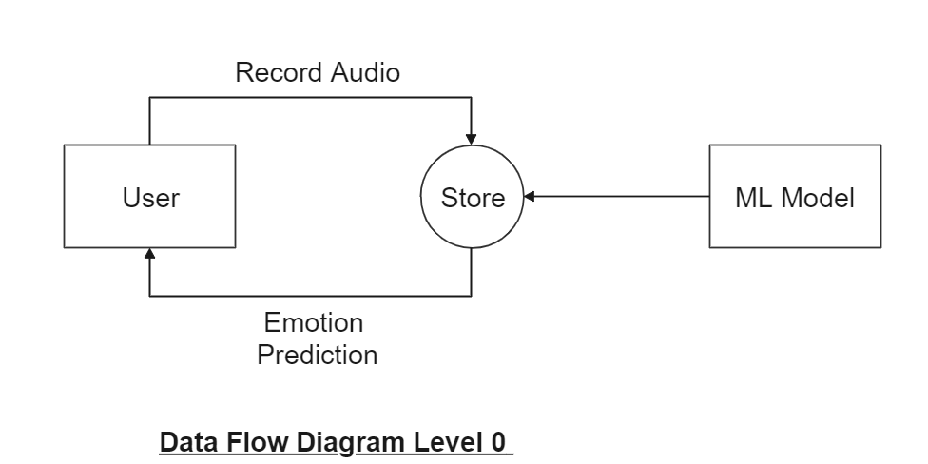
Functional Modeling: Data Flow Diagram

Slide 21
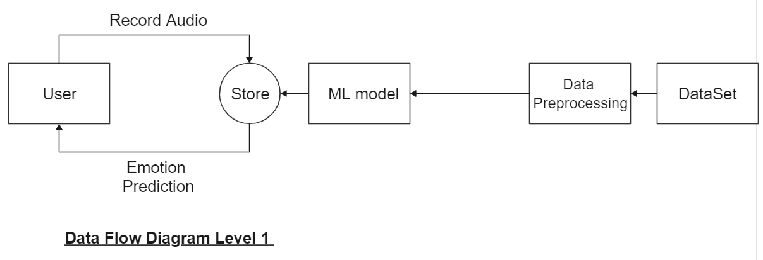
Functional Modeling: Data Flow Diagram

Slide 22
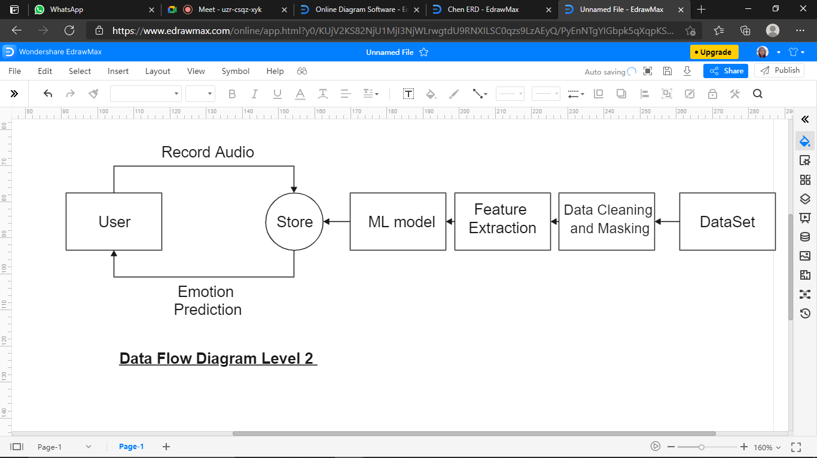
Functional Modeling: Data Flow Diagram

Slide 23
Implementation
Implementation (Current Status/ Main Functions)
  Created User Interface of the application
  Loaded the required RAVDESS Dataset
  Masking and cleaning of Dataset
  Feature Extraction of Audio Files Function
  Labels Classification
  Loading of data and splitting of dataset

Slide 24
References
[1]Proceedings of the International Conference on Smart Electronics and Communication (ICOSEC 2020) IEEE Xplore Part Number: CFP20V90-ART; ISBN: 978-1-7281-5461-9
[2] 2017 4th International Conference on Signal Processing and Integrated Networks (SPIN)
[3] Proceedings of the Third International Conference on Computing Methodologies and Communication (ICCMC 2019) IEEE Xplore Part Number: CFP19K25-ART; ISBN: 978-1-5386-7808-4
[4] International Conference on Inventive Communication and Computational Technologies (ICICCT 2017)
[5] Proc. of the 2017 IEEE Region 10 Conference (TENCON), Malaysia, November 5-8, 2017
[6] 2015 International Conference on Affective Computing and Intelligent Interaction (ACII)

